Slide 1
FLOODAWARE An agent-based model for near real-time simulation of flood events Anton Bommel Pascal Perez

Slide 2
Case Study
NSW
Wollongong LGA
Fairy & Cabbage Tree Creeks catchment

Slide 3
Smart Waterways project
Notes:
SMART at large: funded in 2010 ($60m from Commonwealth, NSW and UOW)
Building completed in 2011, contains 30 teaching and research labs, 150 research staff and 200 postdoctoral students.
Spoke and hub model with at the core the Infrastructure Data & Simulation group: 4 labs, 20 researchers and 10 PhD students.

Slide 4
High Risk Area – Flash Flood
Flood event – August 1998
Topography

Slide 5
Traditional modelling approach
Hydrological model
Rainfall-Runoff
WBNM (Boyd, Rigby & VanDrie, 1996)
Hydraulic model
Runoff-Flood
TUFLOW (WBM, 1989)

Slide 6
WBNM: semi empirical rainfall-runoff model
I – Q = dS / dt (1)
where I = inflow rate at time t (m3/s)
Q = outflow rate at time t (m3/s)
S = volume of water stored on catchment surface at time t (m3)
t = time (s)
The stored volume is related to the outflow discharge by
S = 60. K. Q (2)
where K = lag time between centroids of inflow and outflow hydrographs (minutes).
With :
A Area of the sub-catchment (in km²)
IMP % of impervious area
Q outflow from the subcatchment (in m³/s)
Lag lag time of the sub-catchment (in hours)

Slide 7
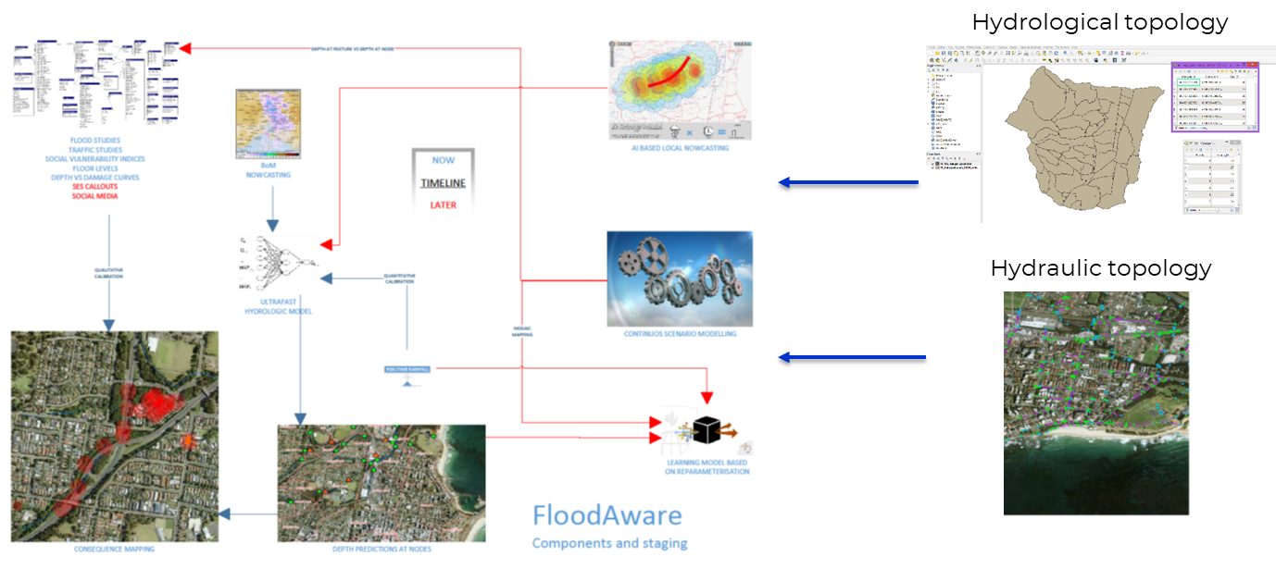
FLOODAWARE: near real-time flood modelling

Slide 8
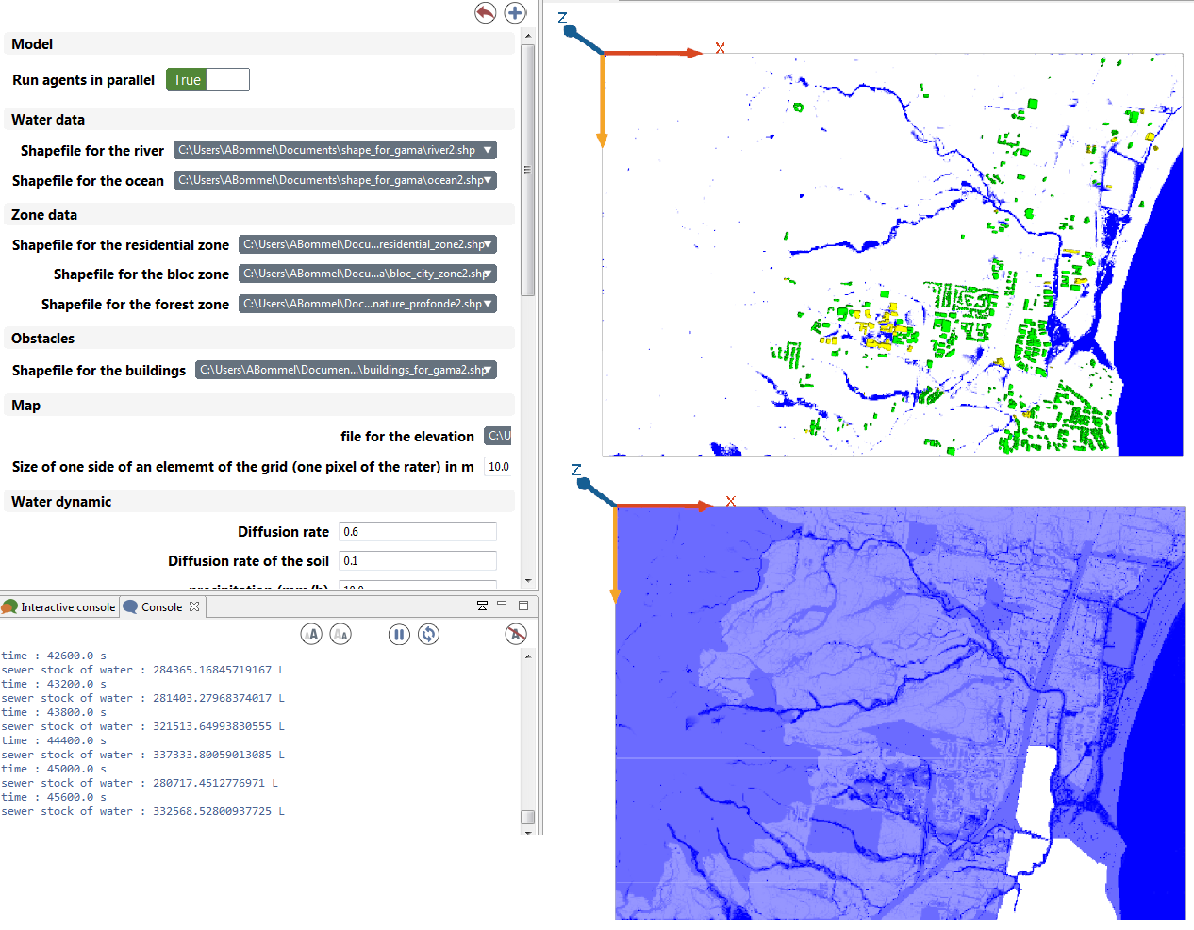
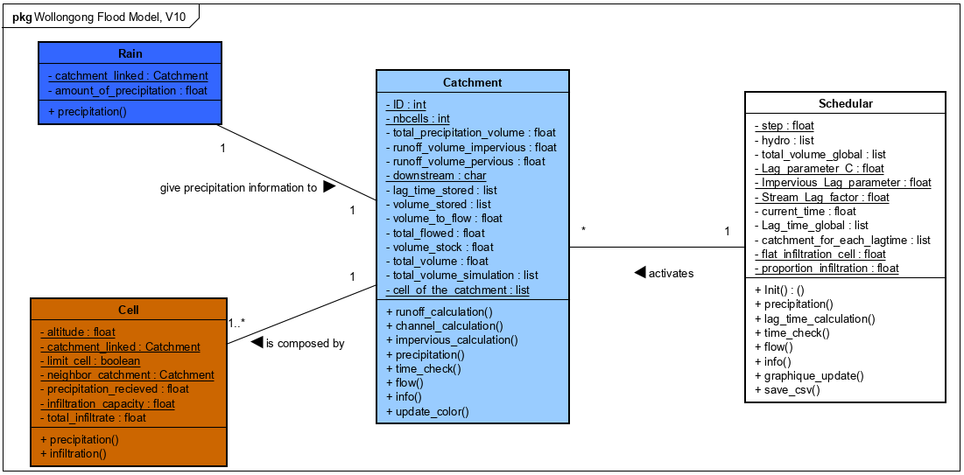
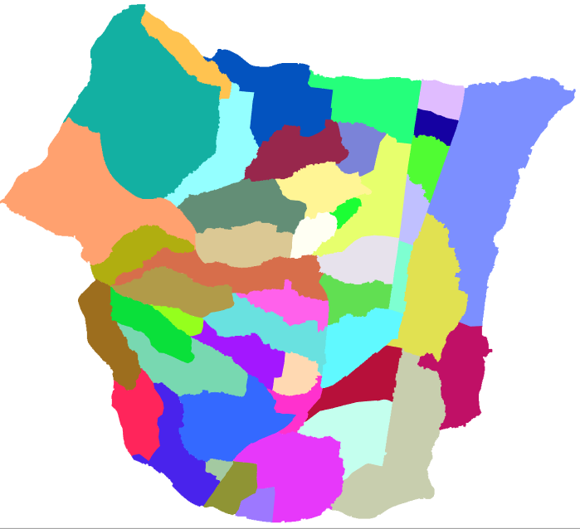
FLOODAWARE: hybrid architecture
Cellular Automaton
Agent-based architecture
Functional sub-basins

Slide 9
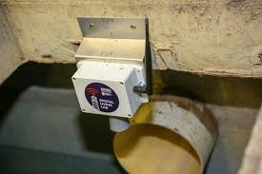
FLOODAWARE: on-the-fly validation & re-calibration
5 min
predict
BOM
radar
Rainfield 3
recalibrate
5 min
predict
WBNM
recalibrate
5 min
Smart sensing network
FloodAware

Slide 10
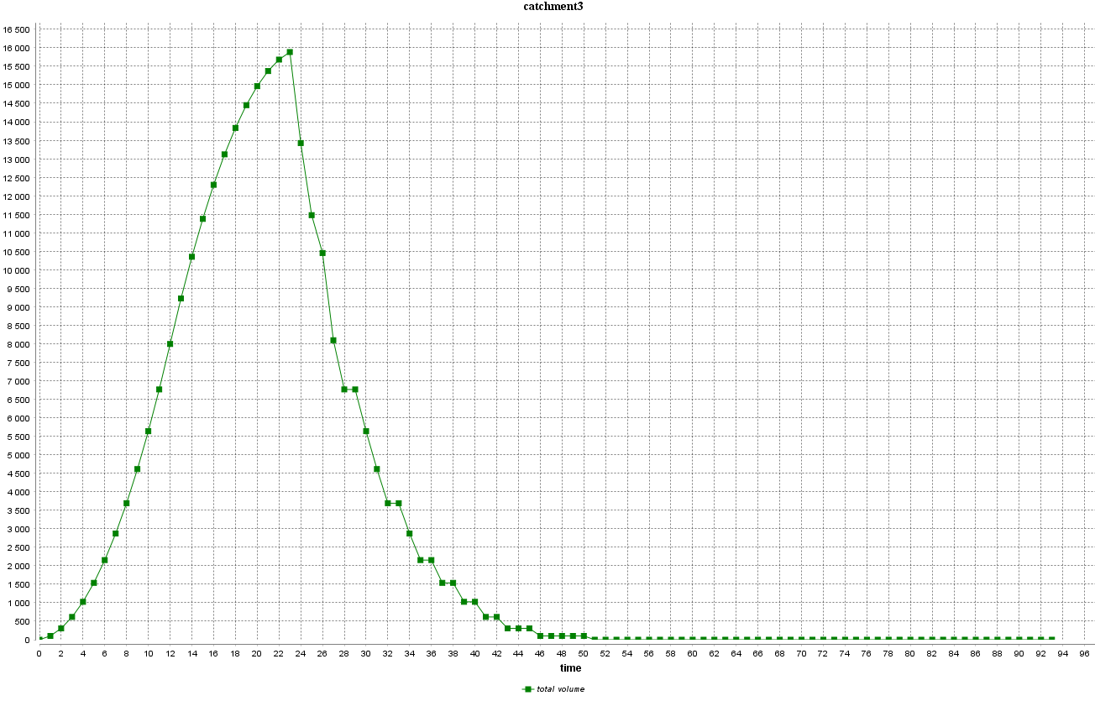
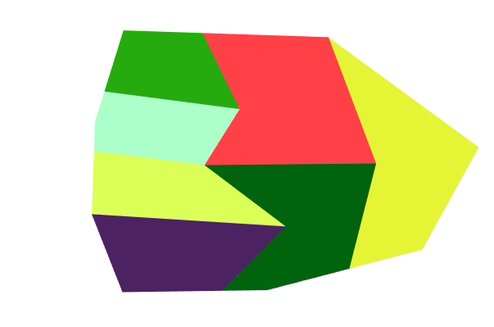
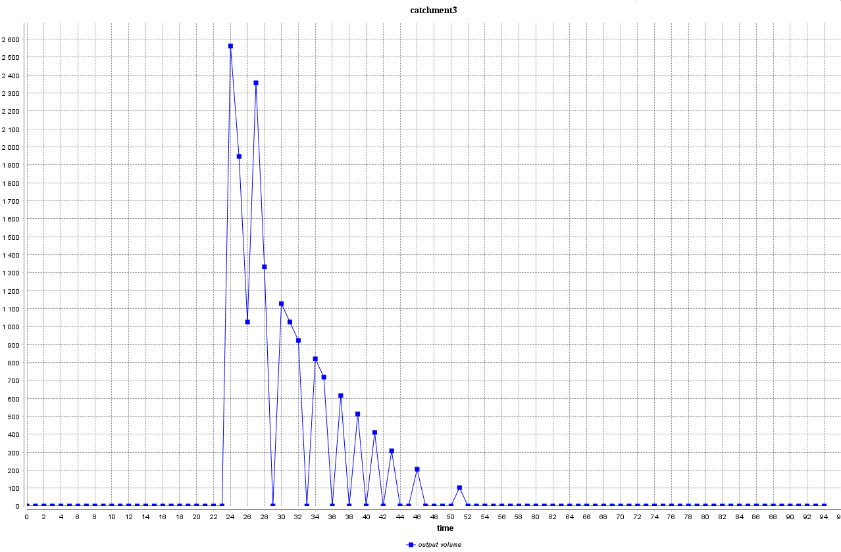
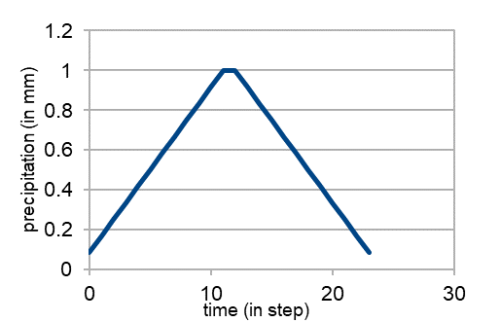
FLOODAWARE: preliminary results

Slide 11
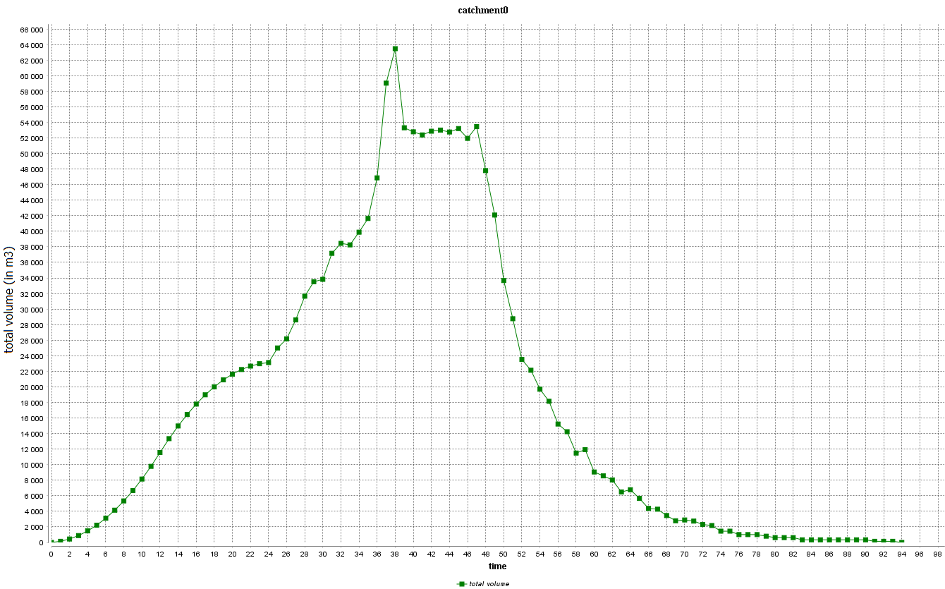
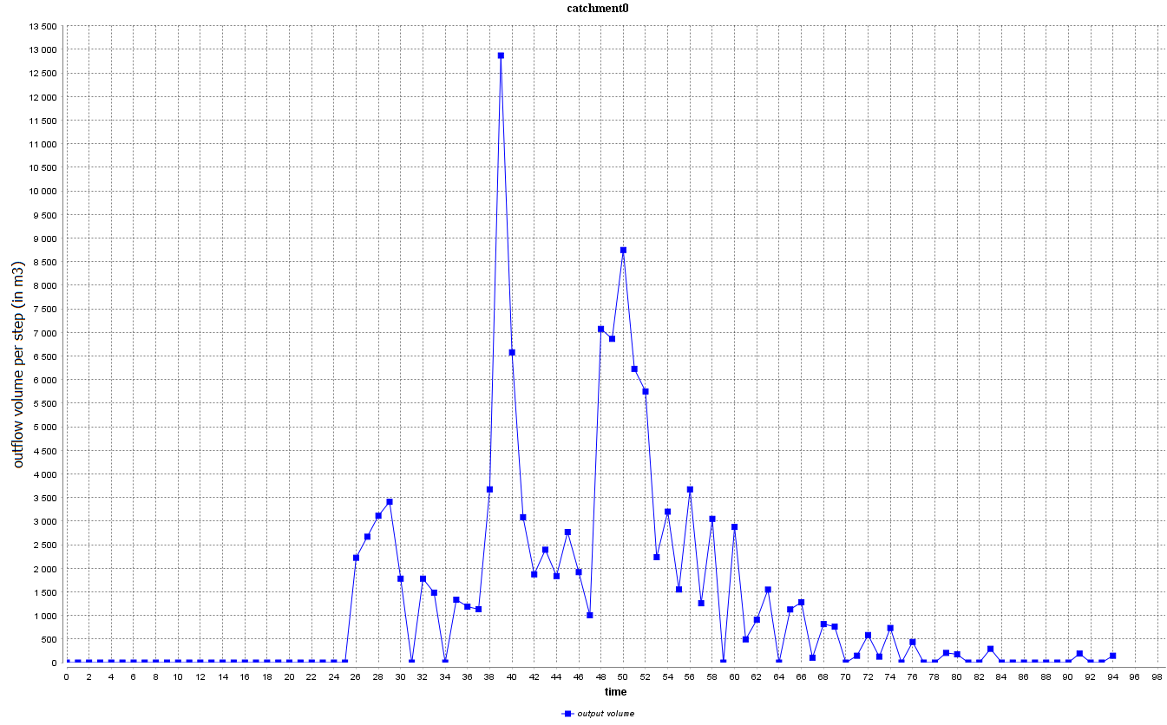
FLOODAWARE: preliminary results

Slide 12
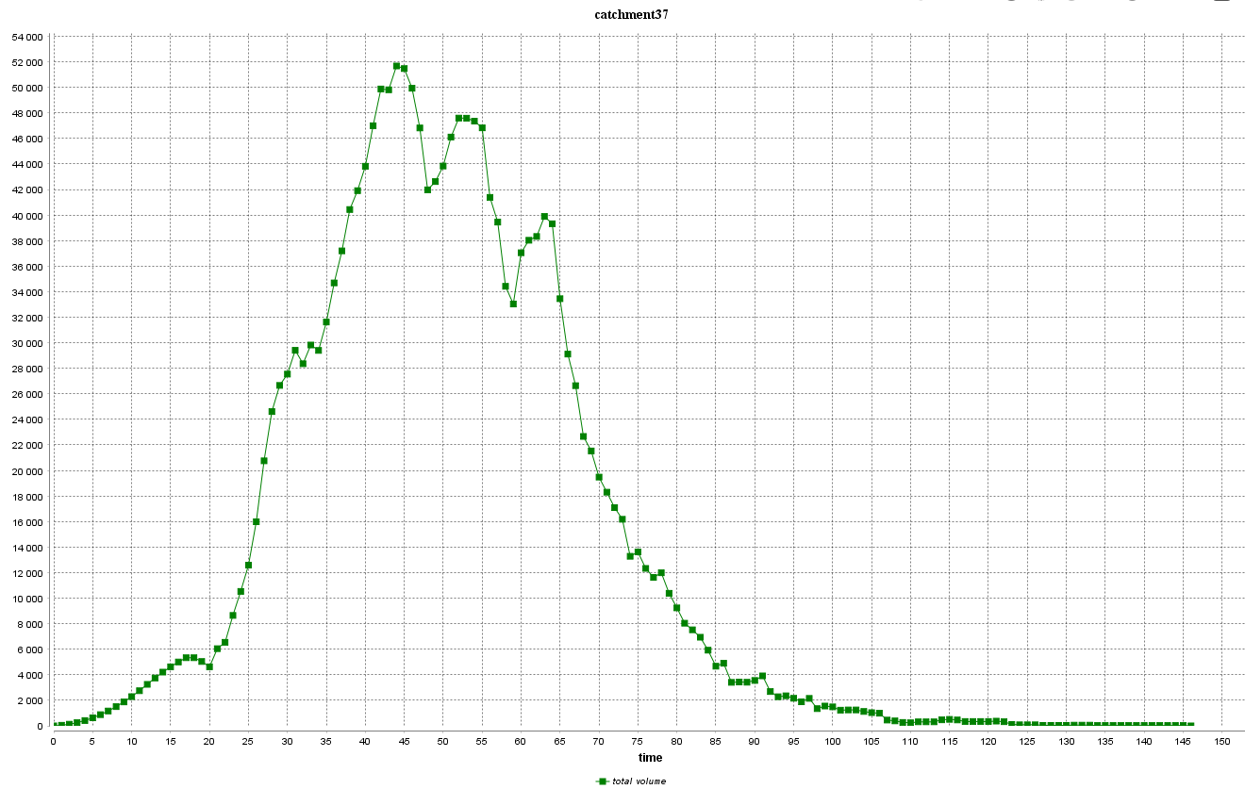
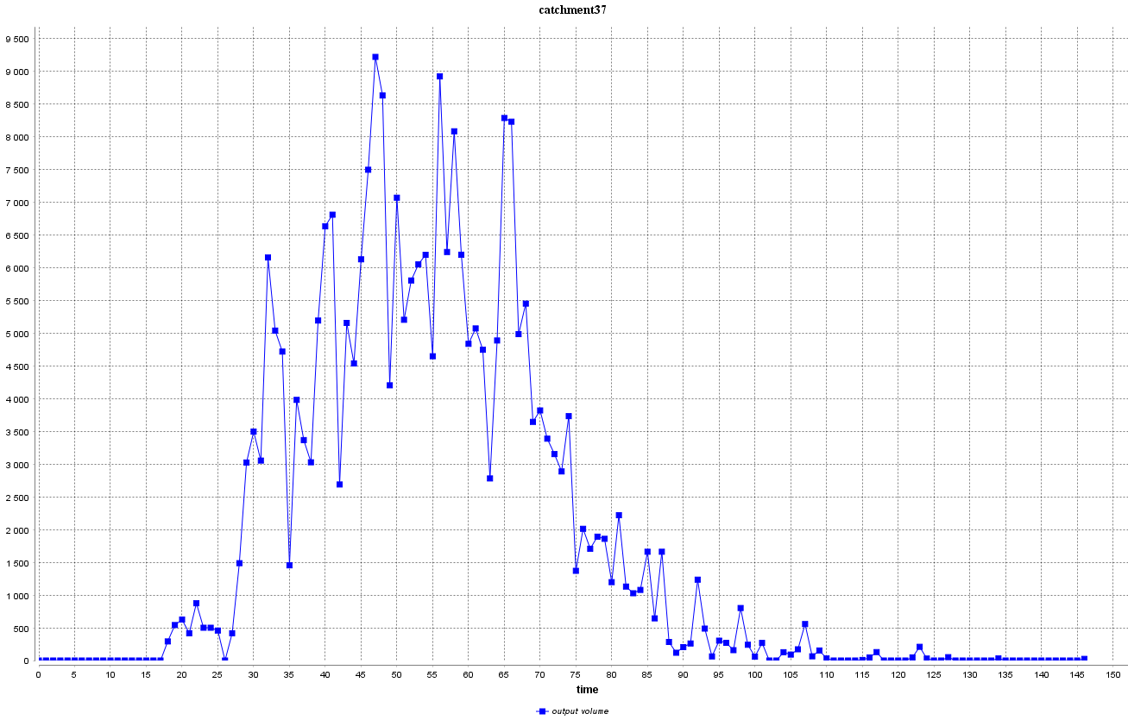
FLOODAWARE: preliminary results

Slide 13
Conclusion
Preliminary results only!
Focusing on operational rather than planning needs
Moving from predictive to self-correcting flood modelling
Ingesting near real time data from smart sensing network
Using AI-based analytics for fast recalibration

Slide 14







KEEP IN TOUCH
pascal_perez@uow.edu.au
@SMART_Facility
smart.uow.edu.au
linkedin.com/company/smart-infrastructure-facility-university-of-wollongong
uowblogs.com/smartinfrastructure
slideshare.net/smart_facility
SMART Infrastructure Facility

